Slide 1
Developing in Windows Docker Containers
Emrys MacInally

Slide 2

Many thanks to our sponsors:

Slide 3


Emrys MacInally
Rollout Manager / DevOps Engineer @ medavis
Working in IT for 18 years
Fell in with PowerShell 15 years ago

Slide 4


Slide 5
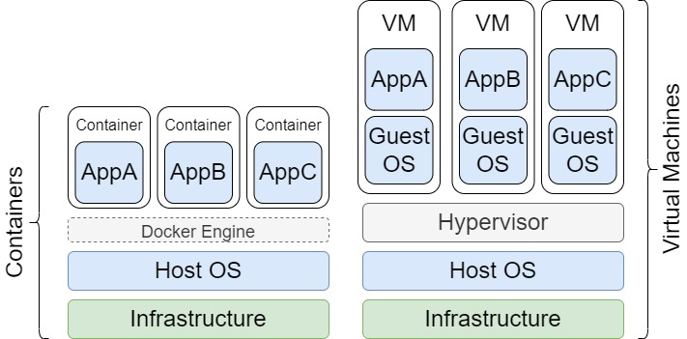
Docker vs. VM

Slide 6
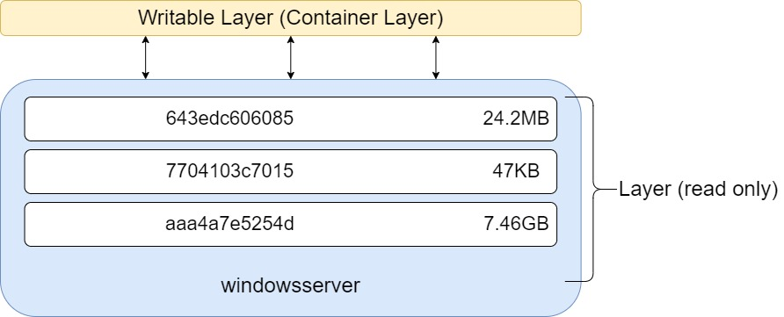
Images and Container

Slide 7
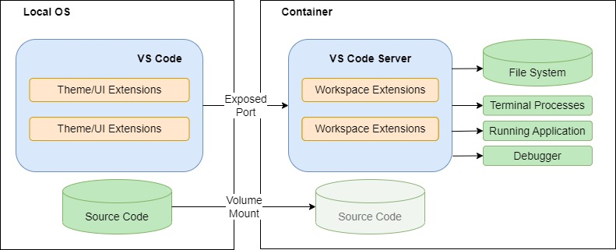
VSCode Dev Container

Slide 8
Demos
We love Demos!

Slide 9
Recap
We created a Windows image with all the components to develop in.
Launched a container and connected to it via VSCode remote extension
Pre-built images can be downloaded from Docker Hub macinally/winpwshdevcontainer:ltsc2019 macinally/winpwshdevcontainer:ltsc2022

Slide 10
Q&A
15 minutes

